Slide 1
HYDERABAD India, MuleSoft Group
[12th Sept 2020, 2:00 PM]

Slide 2
Agenda
Introduction
MuleSoft for Beginners
LIVE DEMO ( Order Management System Module )
Fun Quiz ( Win certification voucher )
Networking
Next Event Announcement

Slide 3
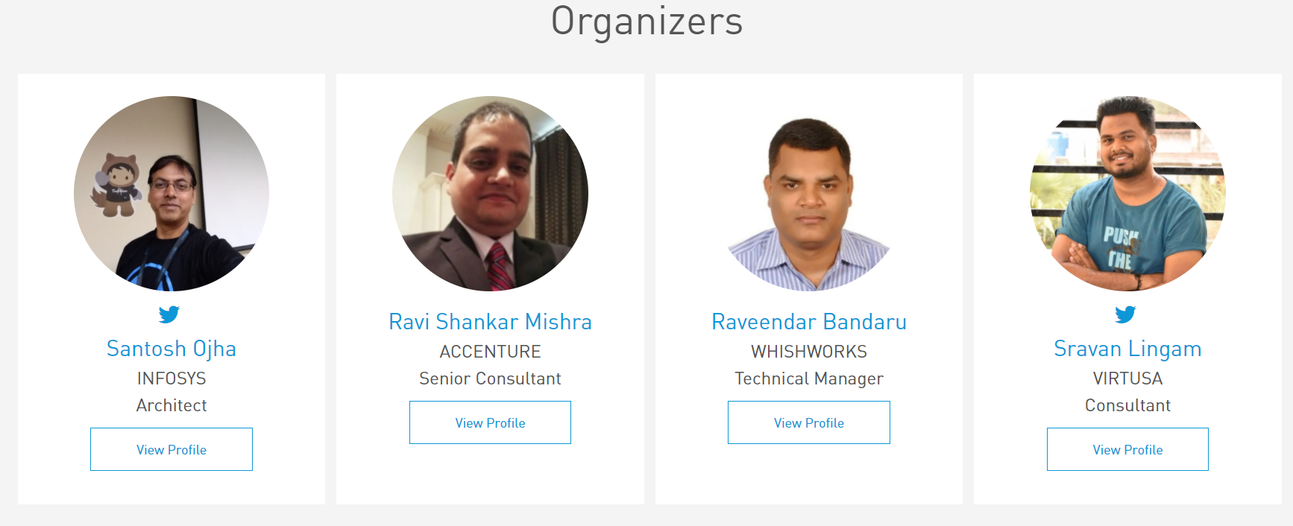
Organizers
Welcome everyone! Thanks for joining us!

Slide 4
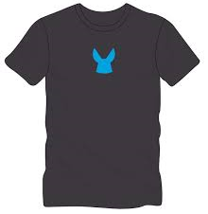
Surprises!
Participate in an online Quiz to win the instructor-led training classes and certification exam vouchers. (3 Winners!)
Be geared up for the quiz sessions at the end ☺

Slide 5
MuleSoft for beginners
Start your MuleSoft Journey

Slide 6
Resources
https://training.mulesoft.com/
https://docs.mulesoft.com/general/

Slide 7
LIVE DEMO : ORDER MANAGEMENT MODULE

Slide 8
Agenda
Introduction
Connect with Salesforce
GET ( LIVE DEMO )
POST ( LIVE DEMO )
Connect with MYSQL Database ( LIVE DEMO )
Introduction to Order Management System
Use Case Live Demo ( Sync Customer From OMS to Salesforce )
Introduction to Change Data Capture
User Live Demo ( Order Creation & Confirmation to Customer )
Q & A

Slide 9
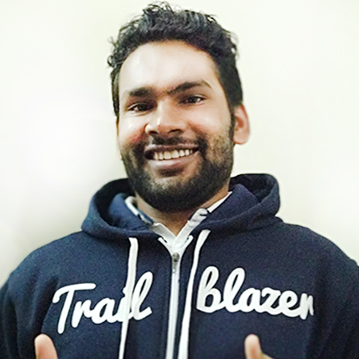
About Me
Amit Singh ( Salesforce MVP )
Salesforce Application Architect
Udemy Author
https://www.linkedin.com/in/simplyamit
https://twitter.com/cloudyamit

Slide 10
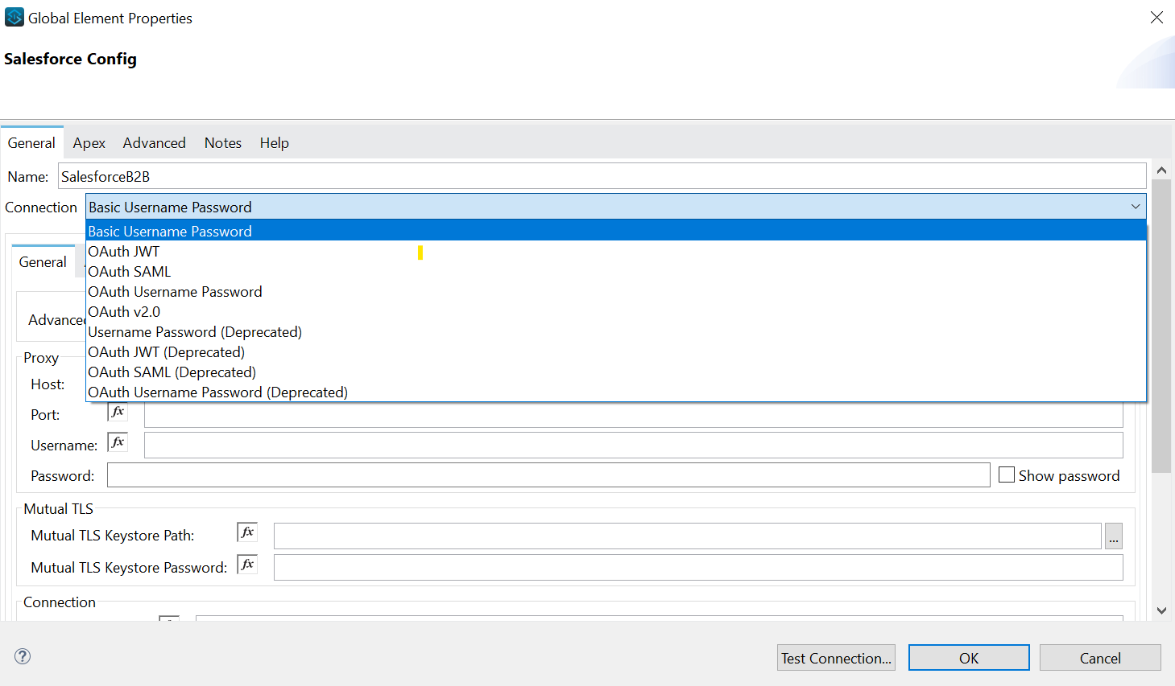
Connect With Salesforce

Slide 11
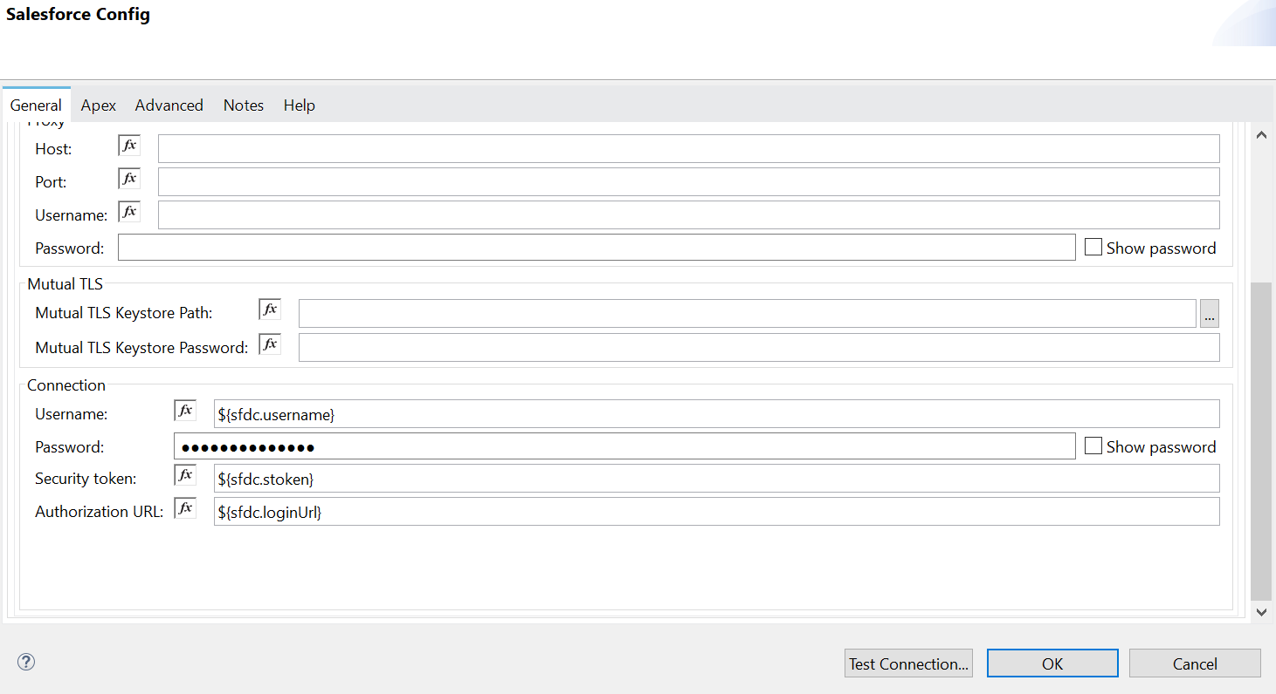
Connect With Salesforce

Slide 12
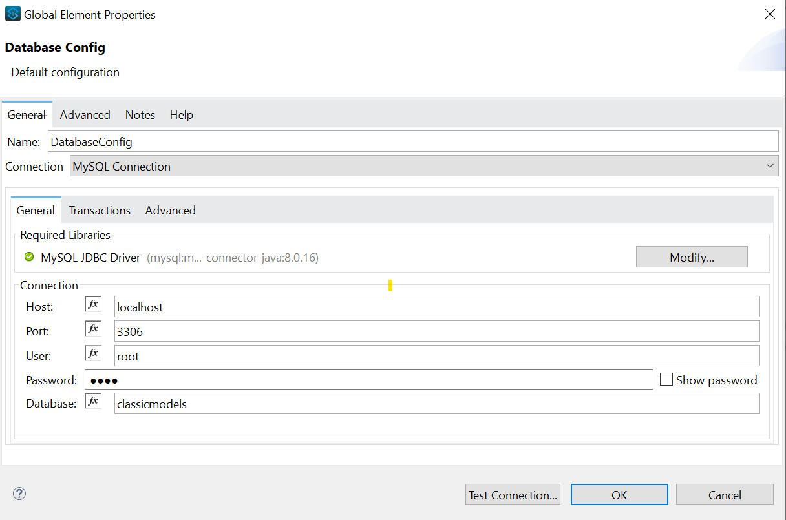
Connect With MYSQL Database

Slide 13











Introduction to Order Management
Typical Order Processing Flow
Amazon
Order Created
Message Received

Slide 14
Introduction to Order Management
Amazon or any other shopping application
Database
OMS
Pricing Database
Inventory
Middleware
etc.

Slide 15

Order Created
In Process
Delivered
shipped
Out of Delivery
At currier

Slide 16







Use Case 1 – LIVE DEMO
Sync Customers to Salesforce
Every 2 Hours
Customer information
in OMS
Salesforce Database

Slide 17




Event-Driven Architecture
Event Producer
Salesforce
Event Bus
Consumer
Consumer
Consumer
SAP
Oracle
Workday

Slide 18
Order-Management ( Salesforce – App )
Salesforce
Product Application
Event Bus
Vendor App
Vendor App
Vendor App

Slide 19
Order-Management ( App - Salesforce )
Salesforce
Product Application
Subscribe
Event Bus
Publish
Vendor App

Slide 20




LIVE DEMO – Use Case 2
Salesforce
Creates Order
in SFDC
MuleSoft Listener
OMS

Slide 21
Q & A

Slide 22
Quiz Time

Slide 23
Take a stand !
Nominate yourself for the next meetup speaker and suggest a topic as well.
Either for our virtual meetup speaker, or in-person meetup speaker.
Surprise swag for upcoming Speakers.
Fill this form -

Slide 24
What’s next
Share:
Tweet/share in LinkedIn , facebook, Instagram with your pictures with the hashtag #HyderabadMuleMeetup #MuleSoftMeetup
Also use #BringMuleSoftConnectToHyderabad to reach our wish to MuleSoft ☺
Invite your network to join: https://meetups.mulesoft.com/hyderabad/
Feedback:
Please fill out the slips with details like are you new to Mule? If so what technology you are currently working , What makes you to think of adopting MuleSoft and what topic you are expecting in future Meetups
Contact MuleSoft at meetup@mulesoft.com for ways to improve the program
Your Feedback is Food for us. You can get $50 as a price money.
Our next meetup:
Date: TBD
Location: Faridabad/Virtual
Topic: TBD

Slide 25
THANK YOU ☺ #Everyone for becoming a part of such a great #community.

